Slide 1
Category review: Chips
Feb 2022
Retail Analytics
Done by,
Sugandh Bansal
Brand note: If client logo is not required, use alternate title page layout right click slide thumbnail > Layout > Title

Slide 2
Notes:
To view Privacy video explaining how important data privacy is to Quantium, please click here: https://www.youtube.com/watch?v=Zq1QDAkoRzU
or here Q:\Company Reference\Brand & Design\Brand videos\Q Privacy.mp4
At Quantium, we believe that data is the behavioural footprint of humanity and that it has to be treated with the utmost care and responsibility.
Histories, attitudes, indeed lives are stored within it in ways that aren’t always apparent – and that’s what makes its potential so powerful.
To work with it responsibly, sensitively, we set ourselves the highest data privacy protection and governance standards.
We have spent 17 years perfecting privacy-by-design and secure-by-design principles. Central to this is not holding any personally identifiable information about people –
we neither receive it, and put the necessary protections in place to be unable to decipher it.
Every aspect of handling data is safeguarded: from its de-identification, to its encryption – data security is paramount and of the highest grade.
We pride ourselves on gaining the trust of iconic organisations around the world through years of securely working with their data,
and in turn the trust that builds with their stakeholders.

Slide 3
Executive summary
01
Customer Trends &
Targets Segment
Total sale on different life stages
Monthly sale in year 2018-19
Total sale on brands
Total sale based on packet size and customer segment
Profit by customer segment
Total sale through year 2018-19
02
Trial and control Store Analysis
Comparison between trail and control stores in trial and pre trial period
1- Total average number of customers
2- Average price per unit
3- total average customers in different period

Slide 4
01
Category

Slide 5
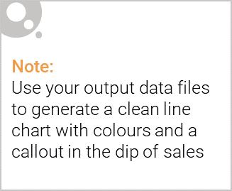
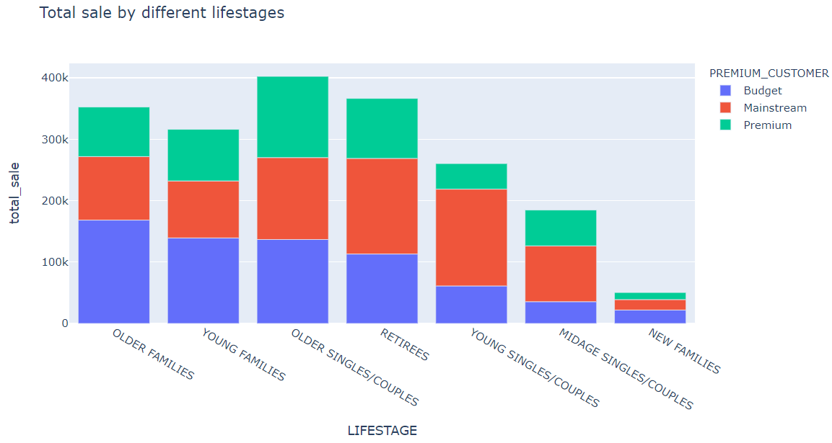
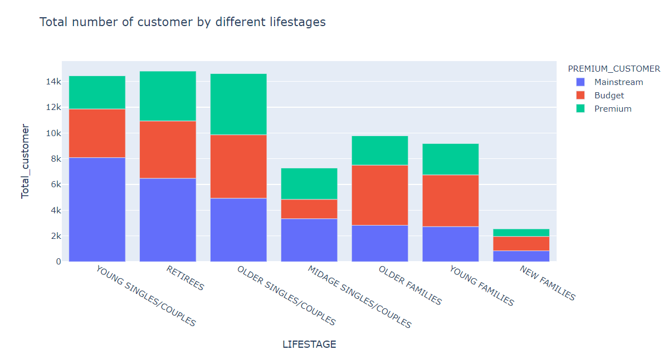
Customer Trends and Target Segment
The top 3 total sales contributor segment are :
Older singles/couples
Retirees
Older families
Retirees, young singles/couple and older singles/couples
are buying different brands though older families are
generating more profit by sales but young singles/couples
are buying multi brand chips.

Slide 6
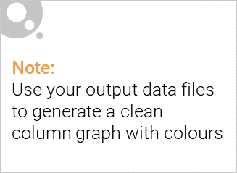
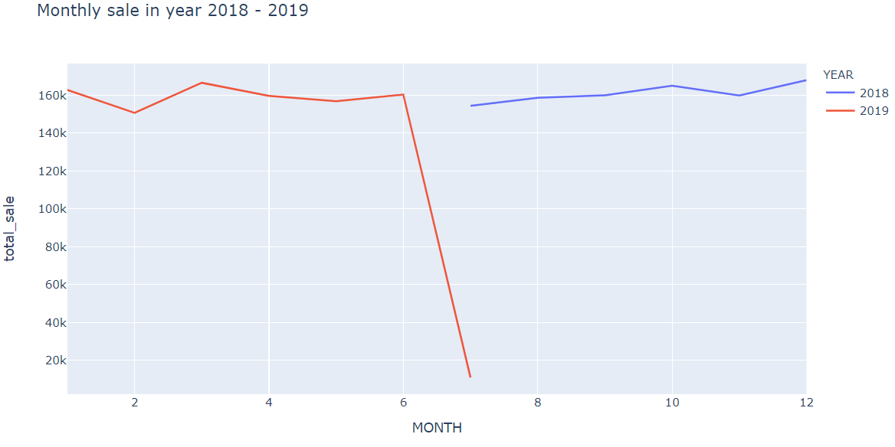
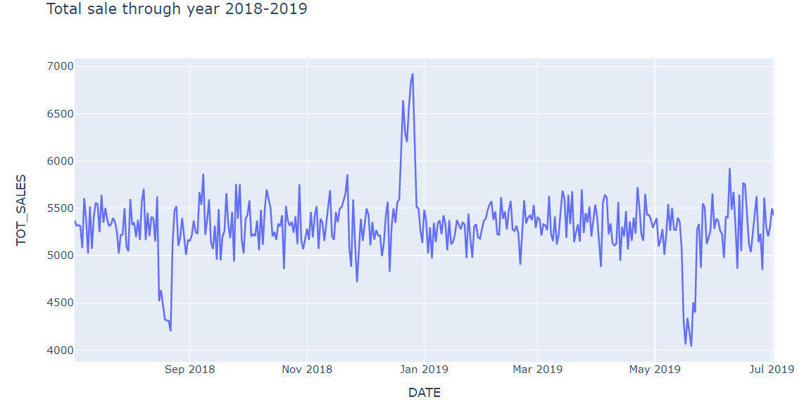
Sale through year 2018-19
In 2018 from October and December sale was on its peak though in 2019 January and March was on highest
Transactions have been more or less same across different months, only in august and may it was down and in December it was on it's peak. May be because of Christmas

Slide 7
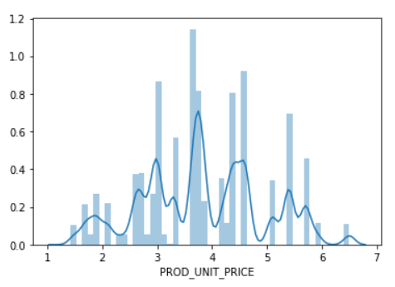
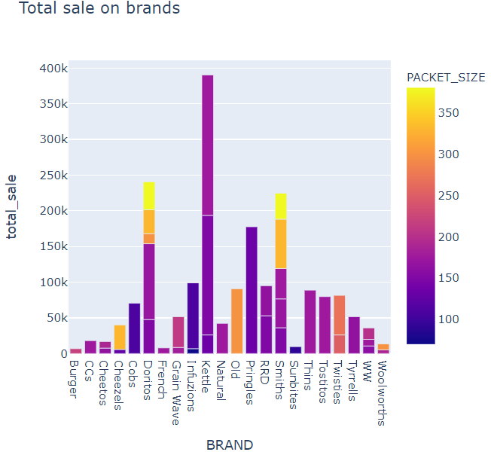
Price range among products
We can see that maximum transactions are for the price range between 3 to 4.5
Kettle, Doritos and Smiths are the most profit generating brands. 170g and above packet size is more popular and in demand Only in Pringles 134g size is popular

Slide 8
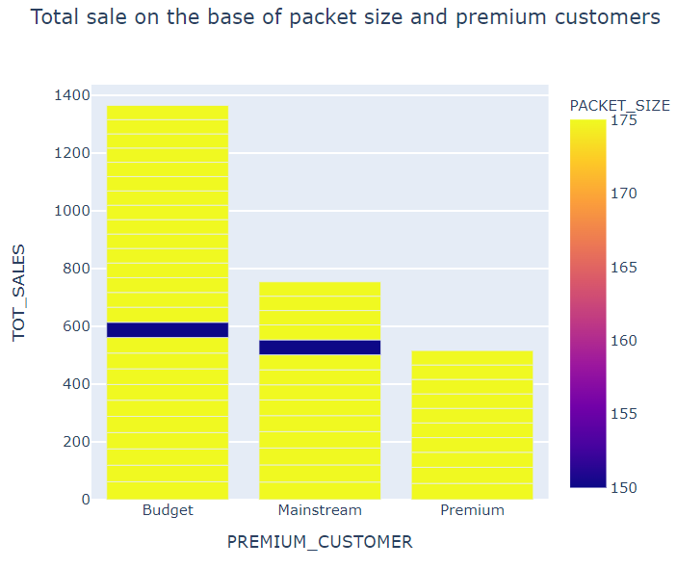
175 g pack is most popular among these three most profit generating customer segments
As seen earlier as well that budget customers are choosing to buy multi brand packets in one transaction as well and also generating most profit

Slide 9
02
Trial store performance

Slide 10
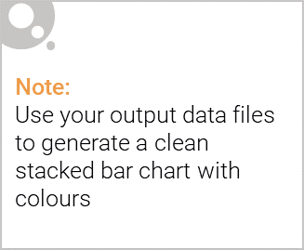
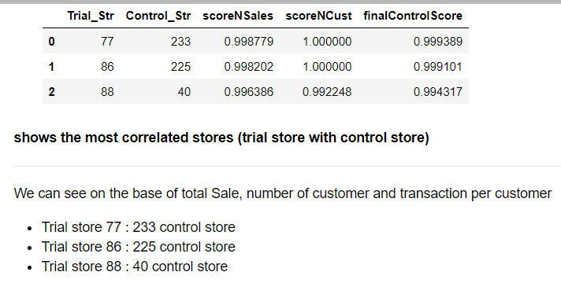
Editable (delete this)
control store for trial store (77, 86, 88)

Slide 11
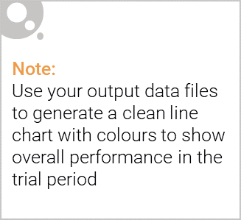
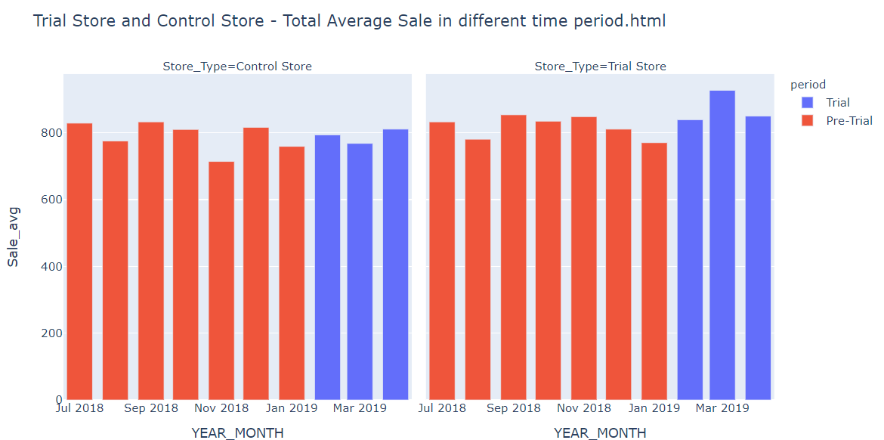
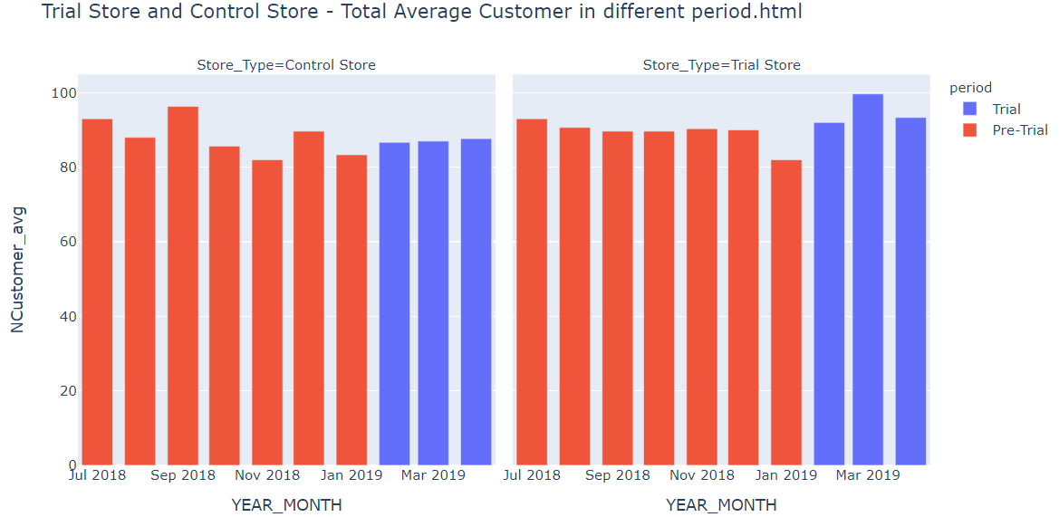
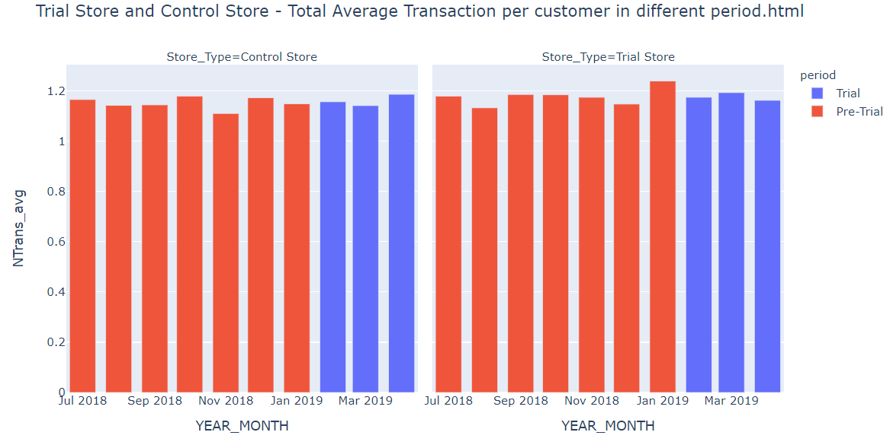
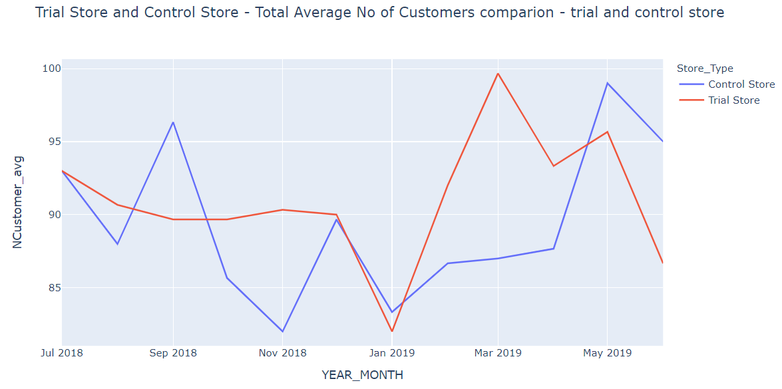
Explanation of the control store vs other stores

Slide 12
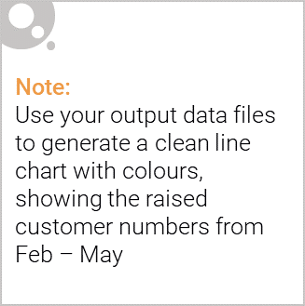
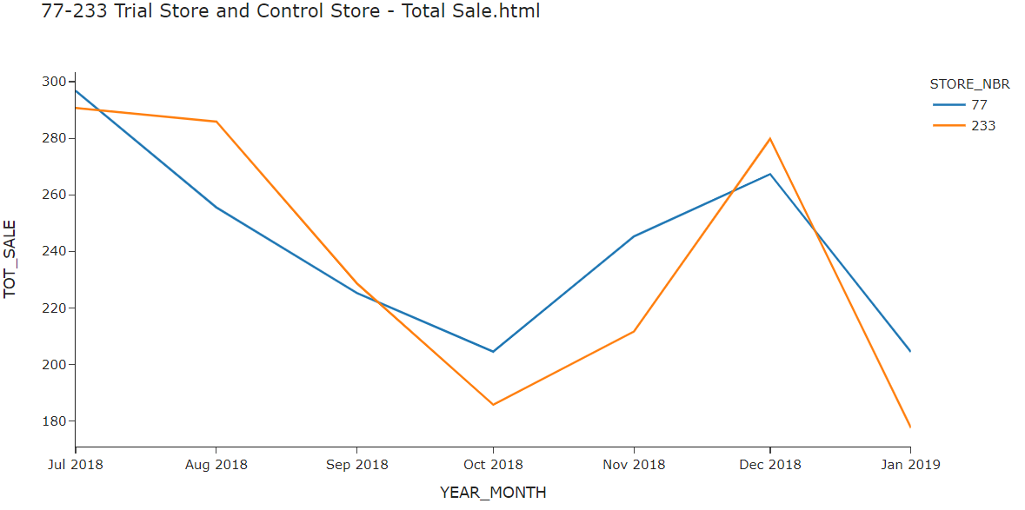
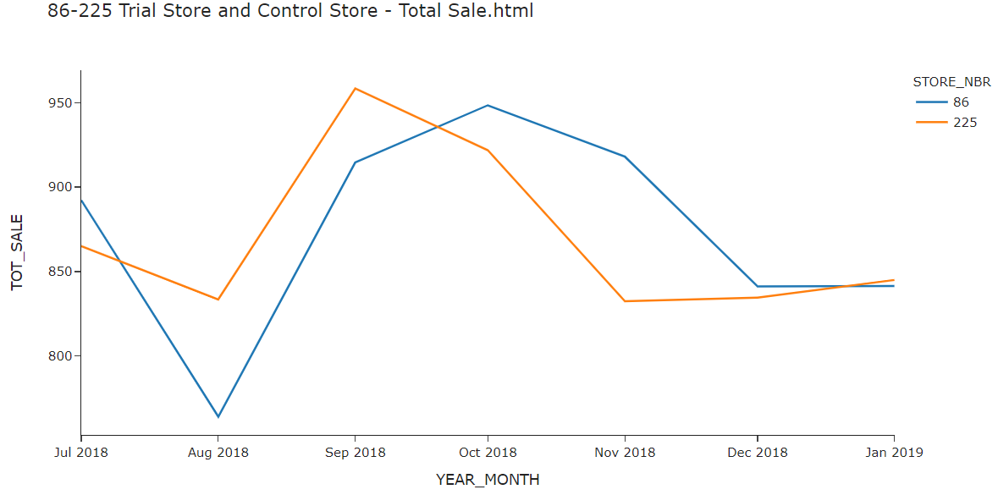
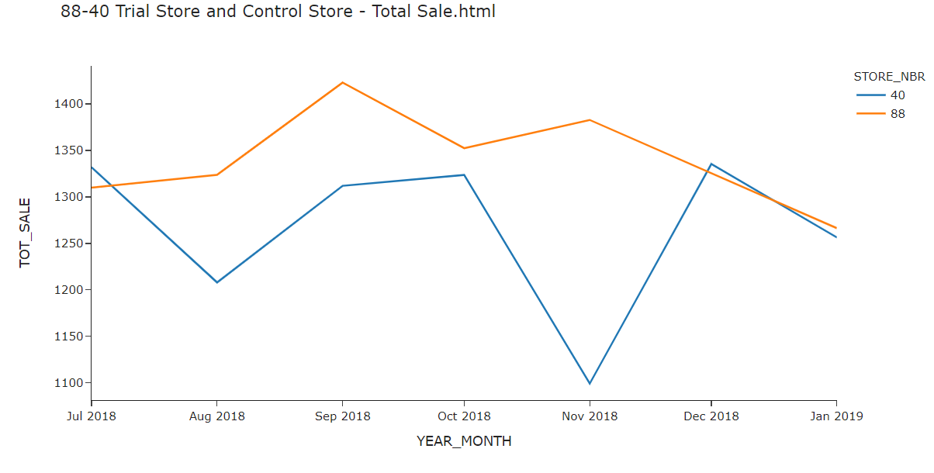
Total sale performance in the trial store, determining if it was successful

Slide 13
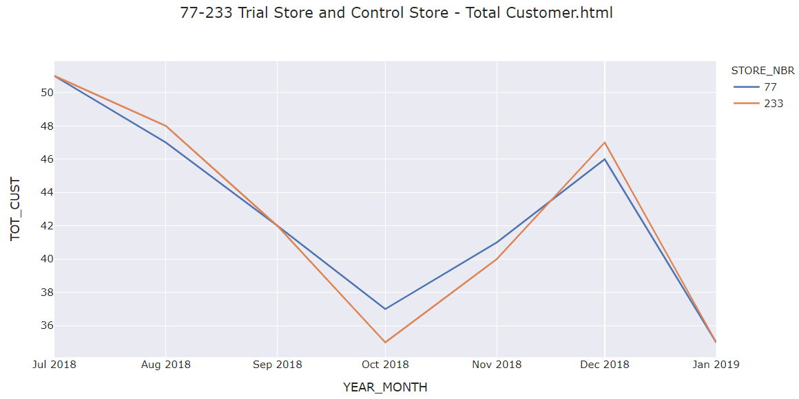
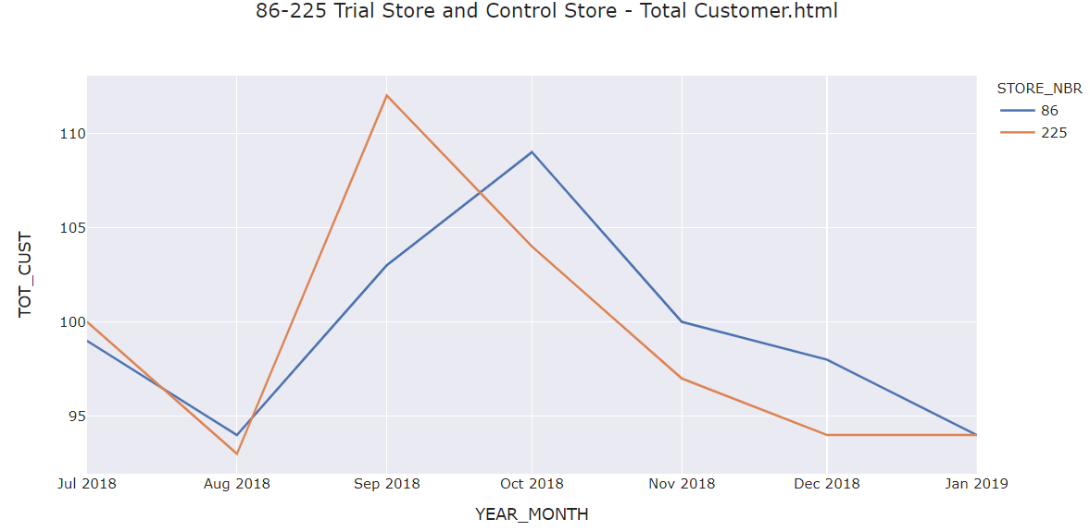
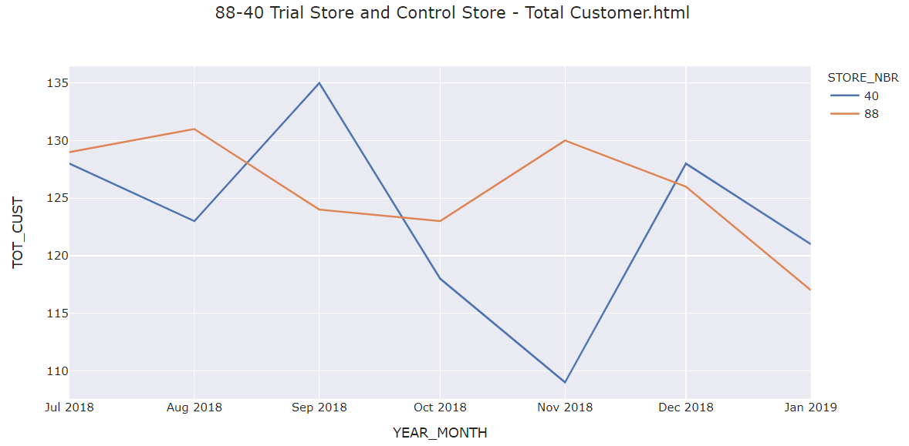
Total customer comparison between trial and control store

Slide 14
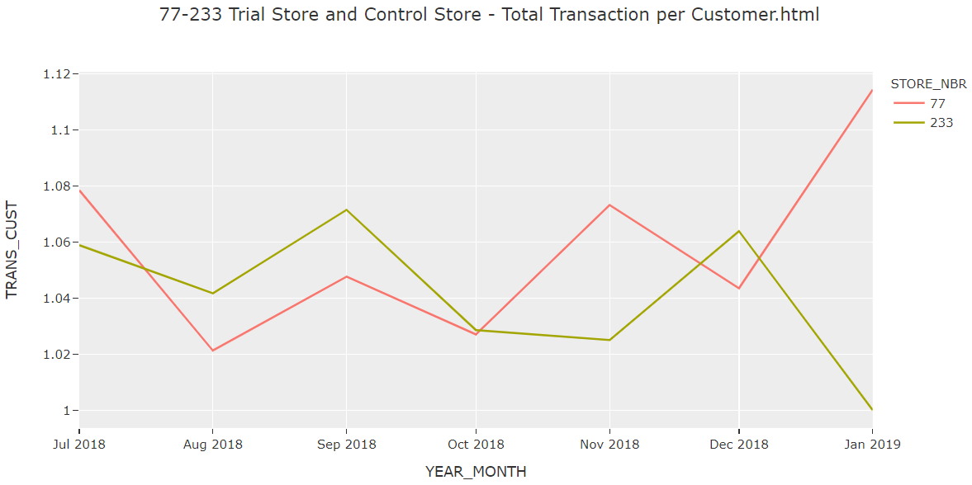
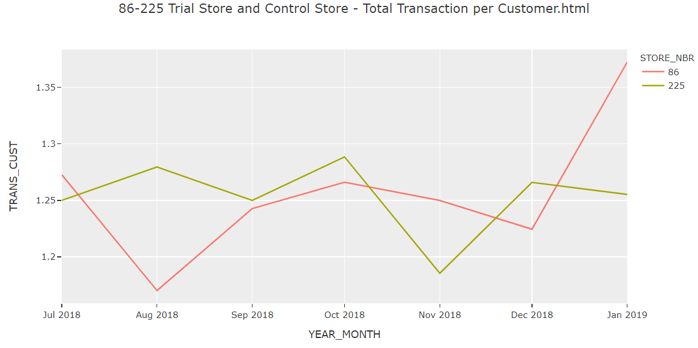
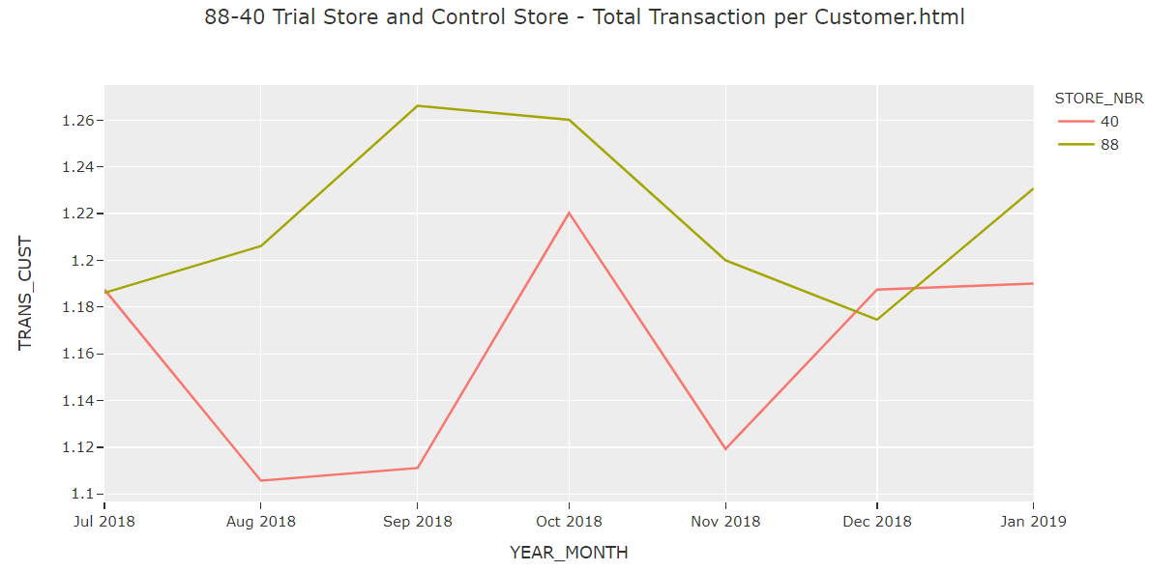
Total transaction per customer comparison between trial and control store

Slide 15
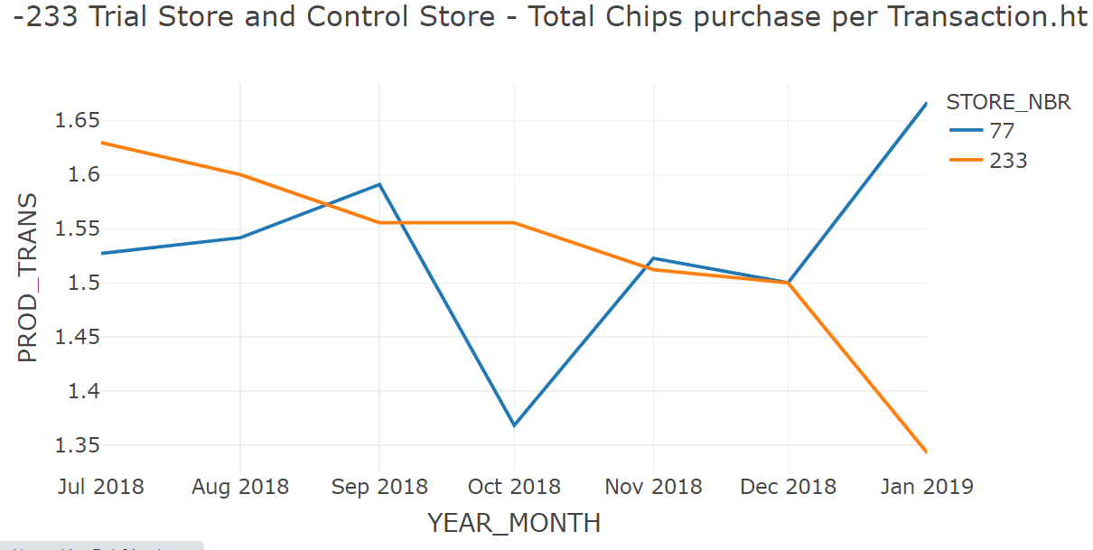
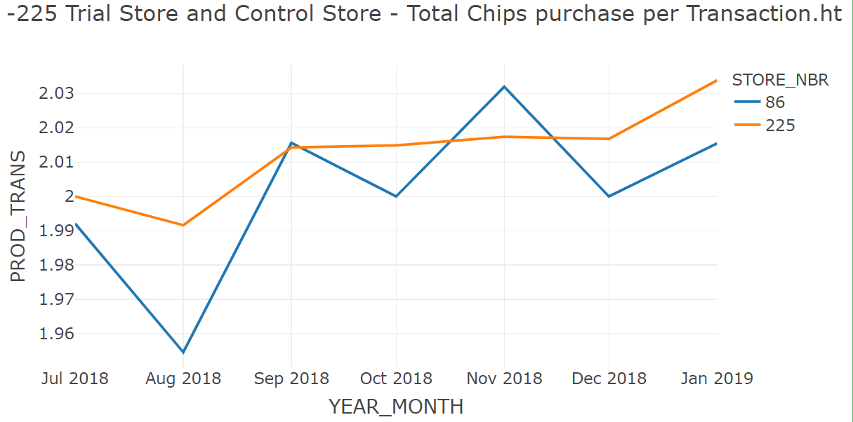
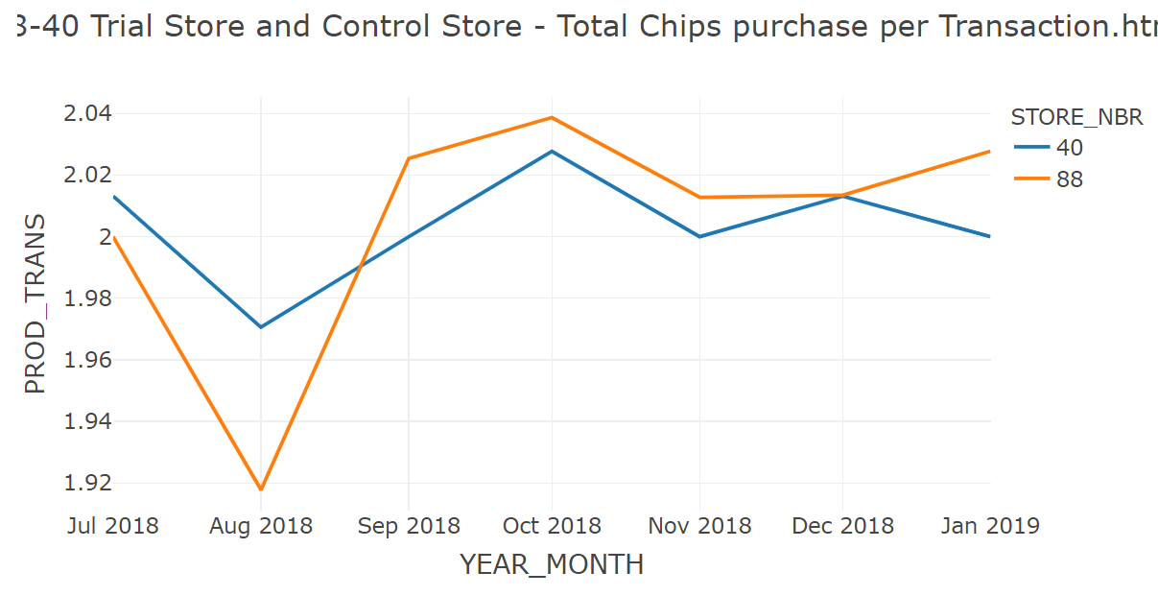
Total Chips purchase per transaction between trail and control store

Slide 16
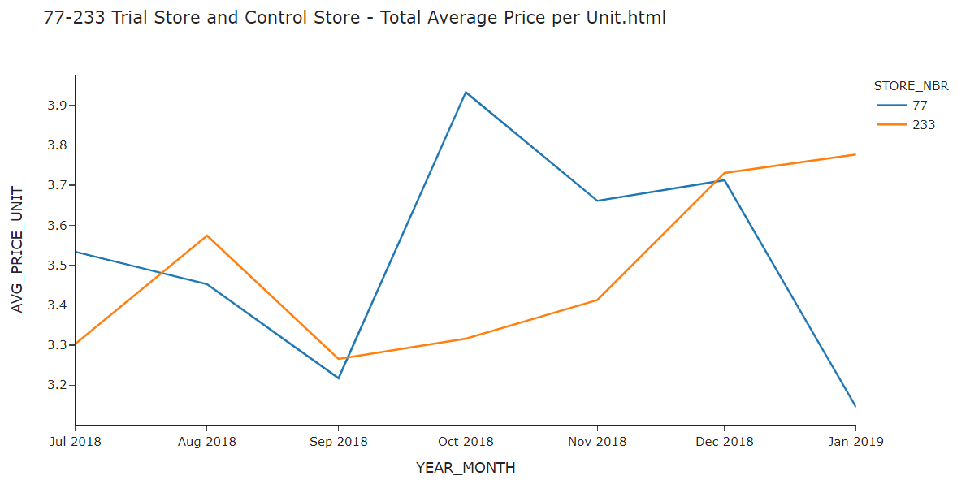
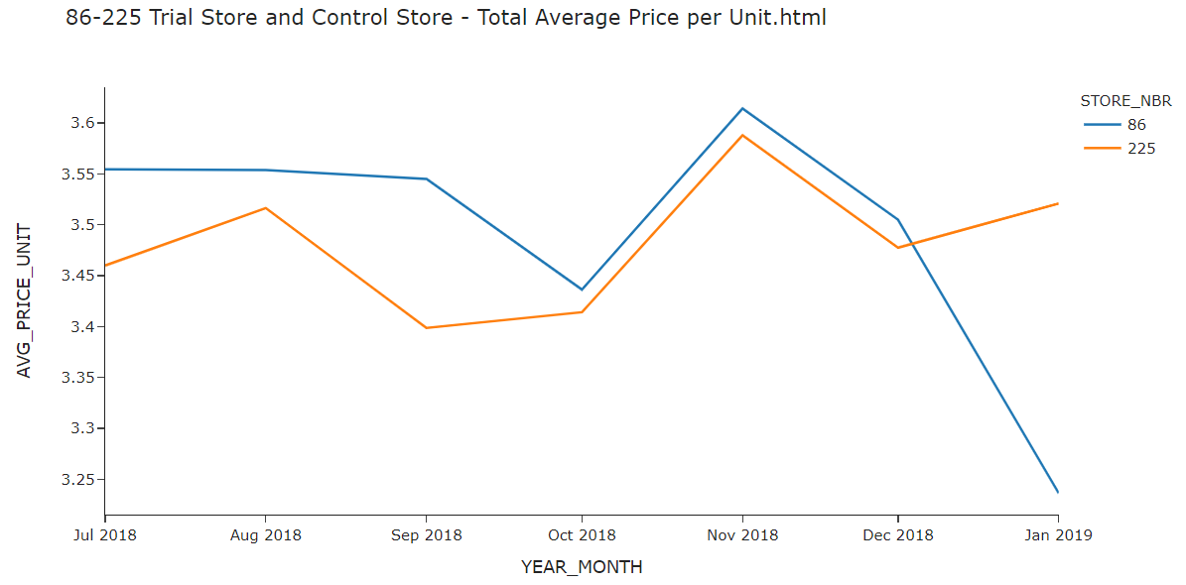
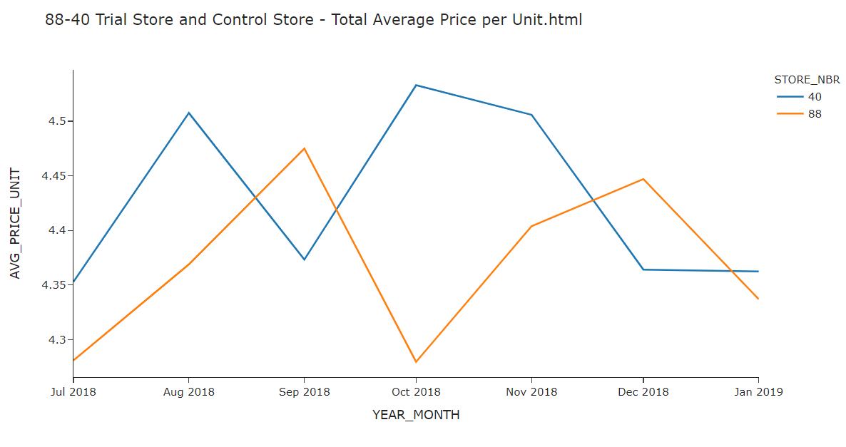
Total average price per unit

Slide 17
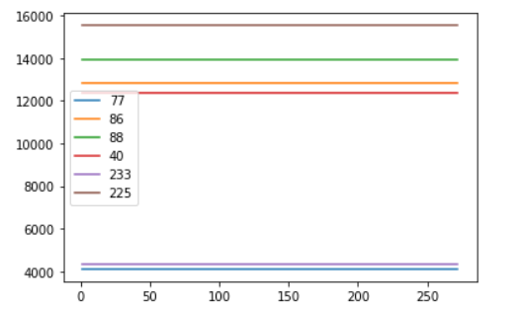
Final Insights
The number of sales is significantly higher in all of the three trial period months. This seems to suggest that the trial had a significant impact on increasing the number of transactions in trial store 88 but as we saw, customer numbers were not significantly higher. We should check with the Category Manager if there were special deals in the trial store that were may have resulted in promotion and can attract more customer to come, impacting the results.

Slide 18
Christmas is an ideal time to increase stock and promotions
Affluence doesn’t seem to affect quantity of purchase per customer. Older and young singles/couples segment have higher average purchase units per customer.
Sales mainly came from budget –older families, mainstream-young single/couples so that should be the target segment
The trail stores saw improvement to sales and number of customers in March. It can be possible that this is due to customer trends outside of the trail store layout changes

